Slide 1

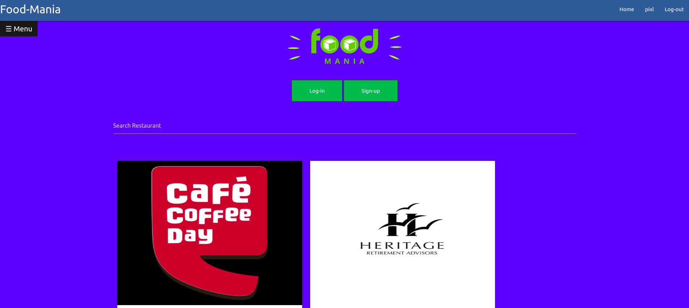
Food-Mania -Group 13
The go to Place for your favourite Restaurants.

Slide 2
About
Food-Mania is a web-site that brings all the Best restaurants of Kharagpur together to provide ease of Business for owners as well as make Ordering Food as simple as a click for the users.
We have aimed to make the interface intuitive for the users and also provide a balance of control between the administrator and restaurant-managers. A user can simply visit our homepage to see the various restaurants near him, select one of them and place the order after seeing the menu. Thus is a end to end service, free of any middleware.

Slide 3
Team Members & Contribution
Akash Tiwari - 17CS10003
Implemented Log-in & Sign-up.
Creating Models & Databases and linking them with front-end.
Implemented Front-End (Home page, About, Restaurant page) and Toasts.
Implemented Dynamic Navigation- bar and Side-Bar using Javascript.
Implemented Feedback/complaint System and Checkout.
Handled User-permissions and admin.
Implemented options like Adding food to menu, adding new Restaurant, Deleting Food from menu, Removing restaurants etc.
Implemented individual search and sorting in admin.
Prashant Shishodia-17CS10039
Implemented Dynamic User-profile page.
Implemented Search-Bar in Homepage for searching restaurants.
Customised Forms(Sign-up,Menu) for sending data.
Implemented Shopping Cart for storing bought items.
Design-Improvements and implemented Front-end.
Testing of site and Bug-Fixing,

Slide 4
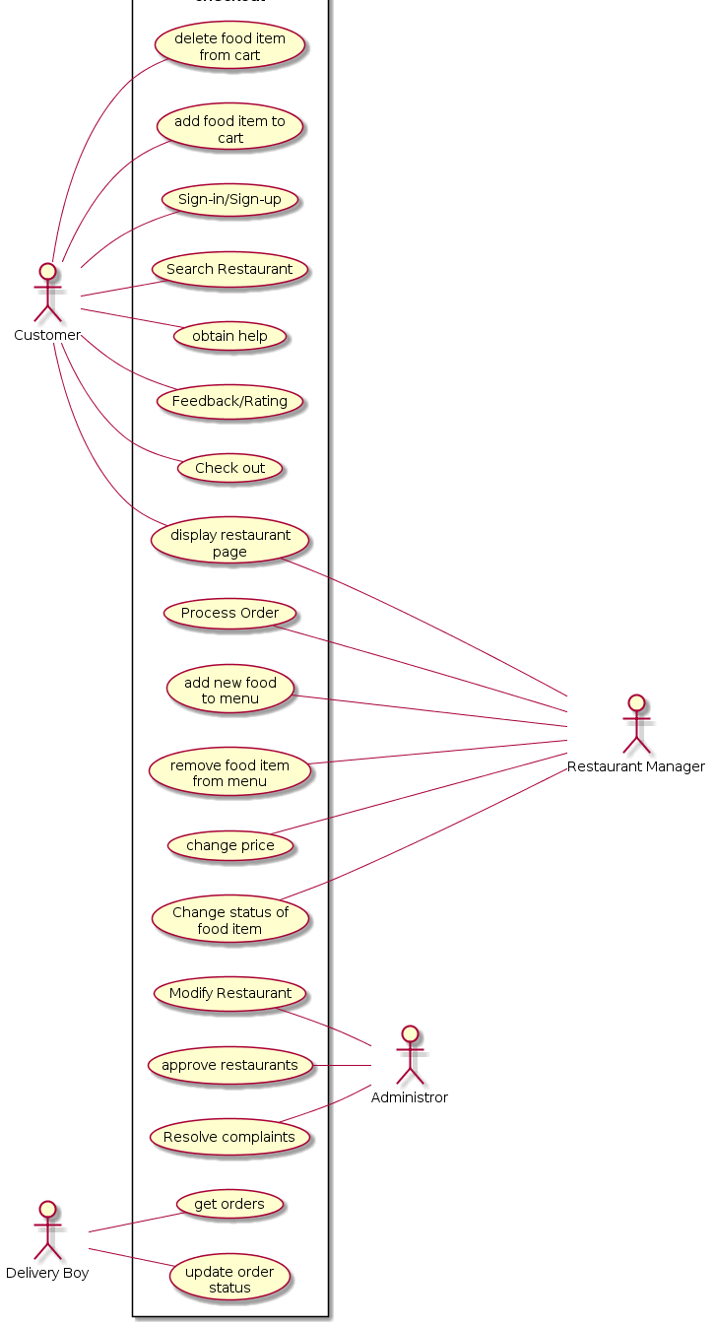
Use case

Slide 5
Environment and Framework
Front-end
For making websites we have used HTML5 and for designing we have used CSS.
For making Dynamic Content, (Like sidebar and Navigation bar) we have used Javascript.
Back-end
For backend we have written scripts in Python 3.6 .
Database( user info, Restaurant Menus, Complaints and Orders) is stored in SQLite.
We have used MVT(Model -View-Template) architectural pattern/Framework.
Models contain the Formatting for storing Database in SQLite.
Views contain the response to a particular request from a URL.
Templates contains the Final HTML pages to be returned.

Slide 6
Overall Progress
We have implemented all the use-cases that were present in our use-case diagram(as First Release).
Implemented user sign-in/sign-up and Staff member sign-in/sign-up.
Implemented global and dynamic sidebar and navigation bar.
Implemented ordering of Food and shopping cart.
Implemented modification, addition and deletion of food from Their menu.
Implemented modification, addition and deletion of Orders by Delivery boy and Restaurant.
Implemented a complaint/ Feedback system.
Implemented Personal user page.
Implemented search and sorting for admin as well as home page.
We have also implemented some basic framework for Release 2 (like making the menu visually appealing by adding pictures).
We plan to further improve the permissions for better Handling and Security.
We also plan to include more Customisation for existing user page, which will include their past Order History and their Complaints status info .
We will further allow the users to connect their Facebook and twitter accounts with the app and also log-in via them.

Slide 7
Challenges Overcome during Development
Implementation of user-page was a major challenge as it had to show content according to user logged in using only 1 URL(due to security reasons). We solved this by making a common template for all users and viewing the data by retrieving individual data from user database.
Implementation of Cart was another major challenge as it is supposed to keep track of all fields in the form at all times, we solved this by updating cart data dynamically using Javascript.

Slide 8
Demo

Slide 9
THANK YOU

